Slide 1
Lecture 06-07 Constitutional/Legal Development in Pre-Partition Era

Slide 2
Minto-Morley Reforms: Indian Councils Acts 1909
The Indian Councils Act 1909, commonly known as the Morley-Minto Reforms or Minto-Morley Reforms, was an Act of the Parliament of the United Kingdom that brought about a limited increase in the involvement of Indians in the governance of British India.

Slide 3
Salient Features:
The number of the members of the Legislative Council at the Center was increased from 16 to 60.
The number of the members of the Provincial Legislatives was also increased. It was fixed as 50 in the provinces of Bengal, Madras and Bombay, and for the rest of the provinces it was 30.
The member of the Legislative Councils, both at the Center and in the provinces, were to be of four categories i.e. ex-officio members (Governor General and the members of their Executive Councils), nominated official members (those nominated by the Governor General and were government officials), nominated non-official members (nominated by the Governor General but were not government officials) and elected members (elected by different categories of Indian people).
Right of separate electorate was given to Muslims.

Slide 4
Cont.
At the Center, official members were to form the majority but in provinces non-official members would be in majority.
The members of the Legislative Councils were permitted to discuss the budgets, suggest the amendments and even to vote on them; excluding those items that were included as non-vote items. They were also entitled to ask supplementary questions during the legislative proceedings.
The Secretary of State for India was empowered to increase the number of the Executive Councils of Madras and Bombay from two to four.
Two Indians were nominated to the Council of the Secretary of State for Indian Affairs.

Slide 5
Cont.
For the first time, the demand for a separate electorate was accepted. Constitutional recognition of Separate Electorate was an excellent achievement for the Muslims. Muslims could now have their representative members at the Legislative Councils. They were to be elected by Muslims alone.
The Indians were not satisfied with these reforms. Strict qualifications of property and education were imposed on the franchise. Consequently, the number of voters was restricted. Moreover, the system of election was indirect. The members of local bodies were elected by the people who, in turn, were to elect members of electoral colleges. The members of electoral colleges were to elect members of Provincial Legislature who, in turn, were to elect members of Imperial Legislature.
To win the support of maximum factions of the society, the Government wanted to give special representation to the loyalist classes. In this context, a unique representation was given to landlords, chambers of commerce and other influential groups.
Further, S.P. Sinha, an Indian, was included in the Viceroy’s Executive Council. However, this act was bitterly criticized by the Muslims, for they had previously demanded that two Indian members including one Muslim should be included in the Council. The Government promised to appoint Muslim the next time. After Sinha’s resignation, Sayed Ali Imam was appointed as a Member of the Executive council.

Slide 6
Criticism
Demand of responsible government was rejected.
Importance of landlords and industrialists increased which was represented by the common Indians.
Restricted franchise (Women were not given the right to vote).
Hindu Reaction
The Hindus organized a demonstrative campaign against this act as they were against separate electorate given to the Muslims. The Congress condemned it and demanded the withdrawal of separate electorate. However, benefitted as result of the act, the Muslims warmly welcomed this act mainly due to the provision of separate electorate for them

Slide 7
Lucknow Pact
The Lucknow pact is considered as a significant event in the political & constitutional history of India.
It is regarded as an excellent example of Hindu Muslim unity.
It was the first and last pact signed between the Congress and the Muslim league.

Slide 8
Factors behind the Pact
The relations between the British government and Muslims were tense due to aggressive and unilateral policies of the British Indian government.
The annulment of the partition of Bengal in 1911 and the British policies in the international system had caused deep distress among the Muslims.
Thus, the Muslims leaderships decided to change the strategy of the Muslim league after the annulment of Bengal in 1911.
In December 1912, the Muslim league changed its aim from loyalty to form self-government suitable to India.
However, the League retained the right to modify self-rule by their needs and requirements.

Slide 9
Features of Pact:
The Congress agreed to the right to separate electorate for the Muslims for the first and last time in the history of the subcontinent.
A weightage formula was proposed under which the Muslims would get less representation than their population in the legislative council in those provinces where they were in the majority but more in provinces where they were in the minority.
Provinces should be given maximum administrative and financial autonomy.
Elections should be conducted by the general adult franchise.
The secretary of the state for India should be given the same powers as are given to the secretary of state for other colonies.
The executive and Judiciary should remain separate from each other.

Slide 10
Cont.
The Muslim League and the Congress should jointly demand the establishment of complete self-government in India.
Any resolution affecting a particular community should require ¾ (75%) majority of the members of that community for its advancement in any council.
All India Muslim League withdrew from the demand that Muslims were in the majority in the Punjab and Bengal.

Slide 11
Importance of the Pact:
The Lucknow pact was a great achievement of Hindu and Muslim leaders, who were successful in offering for the first and last time. It was a mutually acceptable solution of the Hindu Muslim problem.
It appeared to be of particular significance in the history of India. It was the Quaid-e-Azam, who had always been a staunch supporter of Hindu-Muslim unity.
The scheme provided for a substantial step taken halfway towards the establishment of self-rule in India which was the central core of the jointly sponsored scheme of Lucknow Pact.
The Congress for the first time accepted the demand of separate electorate for Muslims.
The pact ensured the protection of political rights of Muslims. Muslim league’s separate status was also accepted.

Slide 12
Cont.
It was a give and take a sort of agreement between both the parties.
The Muslims had to pay a big price of losing the majority in Bengal and Punjab to obtain some concessions.
Similarly, it carried great constitutional significance in the future for many developments.
The scheme of representation of Muslim community in the central and provincial legislatures as embodied in the Lucknow pact was generally followed in the Montague Chelmsford reforms 1919.

Slide 13
Khilafat Movement
The Khilafat movement was a very important event in the political history of India.
The Muslims of India had a great regard for the Khilafat (Caliphate) which was held by the Ottoman Empire.
During World War I, the Ottoman Empire (Turkey) joined the war in favor of Germany.
But Turkey and Germany lost the war and a pact commonly known as Istanbul Accord was concluded between the Allied Forces on 3rd November 1918.
According to this Pact the territories of Turkey were to be divided among France, Greece and Britain.

Slide 14
Failure of Khilafat Movement
The abolition of Khilafat by Kamal Ataturk was a severe blow to Khilafat movement in the sub-continent, and he exiled Sultan Abdul Majeed, a helpless Caliph and abolished Khilafat as an institution, due to this all agitational activities came to an end in the Sub-continent.
The Hijrat Movement made the Muslims disillusioned with the Khilafat Movement due to the declaration of India as Darul-Harab. A large number of Muslims, migrated from Sindh and N.W.F.P to Afghanistan. The Afghan authorities did not allow them to cross the border. After this tragic event, those who had advocated the Hijrat movement come to realize their mistake which failed the movement.

Slide 15
When the Khilafat movement became mature and was reaching its climax a tragic incident took place in the village of Chora Churi in which the police opened fire on the procession of residents. The agitated mob in counteraction set the police station on flames.
Due to this incident, the Muslim leaders were arrested, and Mr. Gandhi put off the movement. As a consequence, the movement lost its intensity.
The Khilafat movement proved that Hindus and Muslims were two different nations as they could not continue the unity and could not live together.
It also created political consciousness among the Indian Muslims about their separate identity, which ultimately paved the way for Pakistan movement.

Slide 16
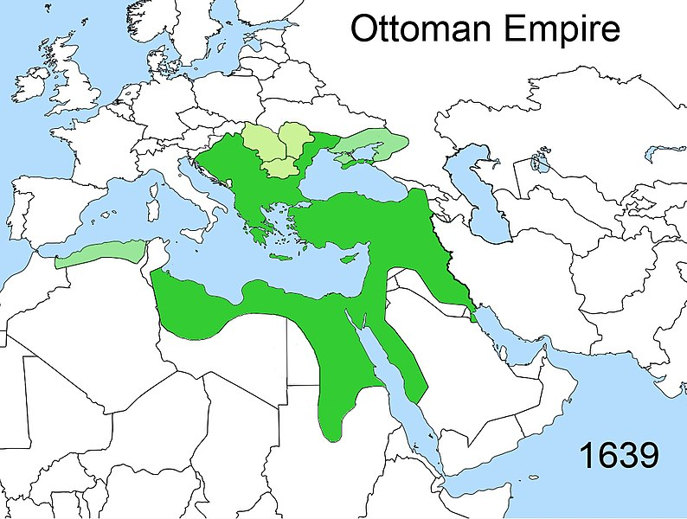
Ottoman Empire

Slide 17
Montague Chelmsford Reforms 1919
Minto-Morley reforms, introduced in 1909, proved unsatisfactory for Indian people. Indians demanded more representation and called for greater self-government. This could not be achieved without a formal reconciliation between Congress and Muslim League.
The Lucknow Pact of 1916 asked for self-rule. Meanwhile, the World War I had started and Indians despite their grievances and discontentment with the British joined the war with over one million soldiers with the hope that after the war British would be obliged to concede to self-rule in recognition of their loyal services.

Slide 18
However, as the war dragged on, Indians became disillusioned as the British did not make any promises regarding self-government. Thus, Indians pressed for immediate reforms and it was felt that a civil disobedience movement might be launched jointly by congress and Muslim league to compel the British to accelerate the reforms.
In view of these circumstances the British felt that something must be done to pacify the Indians. At that time, Edwin Montague was the Secretary of State for India. In his famous August Declaration presented before the House of Commons on 20th August 1917, Montague said that in order to satisfy the local demands, his government was interested in giving more representation to the natives in India.
Lord Chelmsford was sent to India as the new Governor General. He stayed for six months and held numerous meetings with different government and non-governmental people. Edwin Montague in collaboration with Lord Chelmsford collected data and made a report about constitutional reforms in 1918. The report was discussed in the House of Common and later it was approved by the parliament. The Bill was introduced in India in 1919 and became Act of 1919.

Slide 19
Main Features:
The Council of the Secretary of State was to comprise of eight to twelve people. Three of them should be Indian, and at least half of them should have spent at least ten years in India.
The Central Legislature was to consist of two houses, Upper House (Council of the State), and the Lower House (Legislative Assembly). Council of the State was to consist of 60 members, out of those, 35 members would be elected, and the Governor General would nominate rest of them. The Legislative Assembly was to consist of 144 members, out of those 103 were to be elected and 41 to be nominated by the Governor General. The duration of the Upper House was five and of the Lower House was three years.
Powers were divided between the center and the provinces. The important subjects were vested with the center, and unimportant remained with provinces. The important central subjects were defense, foreign affairs, custom, and relations with Indian states, currency, and railway. On the contrary, unworthy provincial subjects were local self-government, public health, education, etc.

Slide 20
The salary of the Secretary of State for Indian Affairs should be paid from British exchequer; previously, his salary was paid by Indian treasury.
The system of ‘Diarchy’ or a kind of double government in the Provinces was introduced.
Provincial subjects were divided into two categories “Transferred and Reserved.” Transferred subjects which were public health, education, local self-government, and agriculture were under the control of Minister; likewise, all transferred subjects were unimportant. Reserved subjects included administration, police, land revenue, etc. which were under the control of Governor with the help of his secretaries.

Slide 21
Congress Reaction
The Congress did not participate in the elections of 1920 under the 1919 Act. It was against these reforms. In 1923, it was decided to participate in elections with a view to destroy the 1919 Act from within.
Muslim League Reaction
The Muslim League did not reject the act as Congress did. Though it was not completely satisfied with the reforms, the initial response was favorable. It too did not participate in the election because of understanding with Congress. Thus, some benefits which the Act could yield were reaped by the Hindus alone.

Slide 22
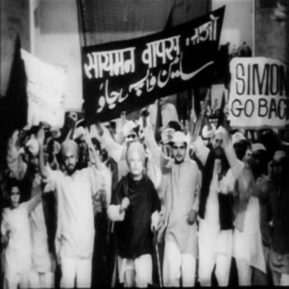
Simon Commission

Slide 23
Simon Commission
Simon Commission, a group, appointed in November 1927 by the British government under Stanley Baldwin to report on the working of the Indian constitution established by the Government of India Act of 1919.
The commission consisted of seven members under the joint chairmanship of the distinguished Liberal lawyer, Sir John Simon, and Clement Attlee, the future prime minister.
Its composition met with a storm of criticism in India because Indians were excluded. The commission was boycotted by the Indian National Congress and most other Indian political parties.
It, nevertheless, published a two-volume report, mainly the work of Simon.
Regarded as one of the classic state documents, the Simon Commission report proposed provincial autonomy in India but rejected parliamentary responsibility at the center. It accepted the idea of federalism and sought to retain direct contact between the British crown and the Indian states.

Slide 24
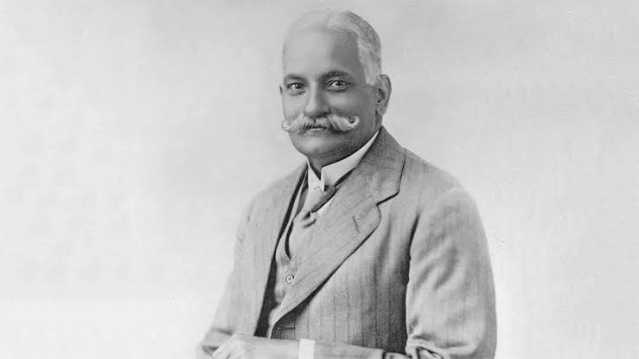
Nehru Report

Slide 25
Nehru Report
Most of the Indian political parties decided to boycott the Simon Commission on the plea that it lacked Indian representation.
The British decided to throw the ball in the court of Indian Politicians. Lord Birkenhead, Secretary of State for Indian Affairs, challenged the Indians, “If they have any political capability and competence then they should form a unanimous constitution and present it to us, and we will implement it.”
Indian political parties accepted the challenge and called an All Parties Conference at Delhi in January 1928. The conference was attended by around hundred delegates from all the important parties including Indian National Congress, All India Muslim League, National Liberal Federation, Hindu Mahasabha, Central Sikh League etc.

Slide 26
Main Features of Nehru Report:
India should be given Dominion Status with the Parliamentary form of Government. There should be a bicameral legislature consisting of Senate and House of Representatives. The Senate will comprise of two hundred members elected for seven years, while the House of Representatives should consist of five hundred members elected for five years.
Governor-General will act on the advice of executive council. It was to be collectively responsible to the parliament.
There should be a Federal form of Government in India with Residuary powers to be vested in Centre
There will be no separate electorate for minorities. It claimed, “Since a separate electorate awakens communal sentiments, therefore, it should be scrapped, and the joint electorate should be introduced.”
The system of weightage should not be adopted for any province.

Slide 27
There will be no reserved seats for communities in Punjab and Bengal. However, reservation of Muslim seats could be possible in the provinces where Muslim population should be at least ten percent.
Judiciary should be independent of the Executive.
There should be 1/4th Muslim Representation at Centre.
Sind should be separated from Bombay provided it proves to be financially self-sufficient.
Reforms should be introduced in NWFP.
The report was not acceptable to Muslims. In the fourth session of the All Parties Conference convened in December to review the Nehru Report, Jinnah representing the Muslim League presented four amendments in the report.

Slide 28
The four amendments were: -
1. There should be no less than one-third Muslim representation in the Central Legislature.
2. in event of adult suffrage not being established, Punjab and Bengal should have seats reserved for the Muslims on population basis.
3. the form of the constitution should be federal with residuary powers rested in the provinces.
4. Sind should immediately be made a separate province and the reforms should also be introduced in NWFP and Balochistan at the earliest.
Jinnah’s proposals were rejected when put to vote in All Parties Conference. The Congress managed to get the majority vote in favour of the Report. They asked the government to make a constitution till December 31 according to the recommendations of Nehru Report and threatened that otherwise the party would start a mass movement.

Slide 29
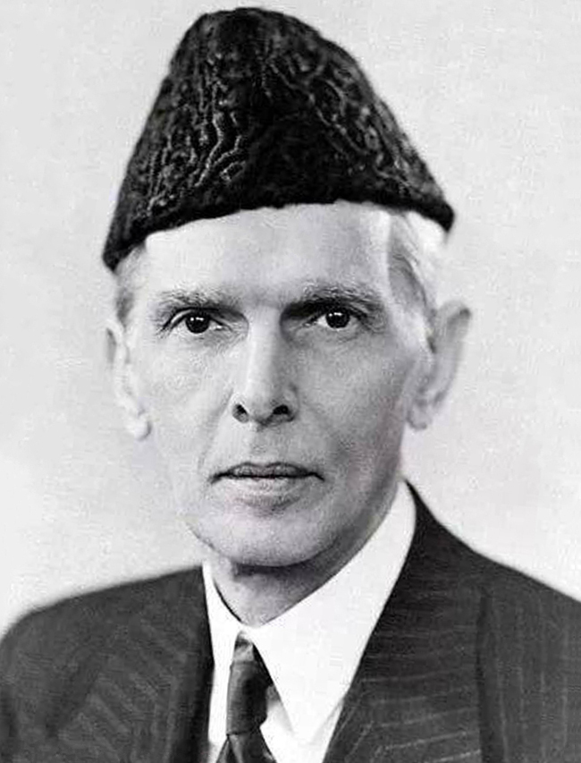
Jinnah’s 14 Points:

Slide 30
Jinnah’s Fourteen Points:
In March 1929, at the annual session of Muslim League, he declared his famous fourteen points
1. The form of the future constitution should be federal, with the residuary powers to be vested in the provinces.
2. A uniform measure of autonomy shall be granted to all provinces.
3. All legislatures in the country and other elected bodies shall be constituted on the definite principle of adequate and effective representation of minorities in every province without reducing the majority in any province to a minority or even equality.
4. In the Central Legislature, Muslim representation shall not be less than one third.
5. Representation of communal groups shall continue to be by separate electorates: provided that it shall be open to any community, at any time, to abandon its separate electorate in favour of joint electorate.
6. Any territorial redistribution that might at any time be necessary shall not in anyway affect the Muslim majority in the Punjab, Bengal and the NWFP.

Slide 31
7. Full religious liberty, i.e. liberty of belief, worship, and observance, propaganda, association, and education, shall be guaranteed to all communities.
8. No bill or resolution or any part thereof shall be passed in any legislature or any other elected body if three fourths of the members of any community in that particular body oppose such a bill, resolution or part thereof on the ground that it would be injurious to that community or in the alternative, such other method is devised as may be found feasible practicable to deal with such cases.
9. Sind should be separated from the Bombay Presidency.
10. Reforms should be introduced in the NWFP and Balochistan on the same footing as in other provinces.
11. Provision should be made in the Constitution giving Muslims an adequate share along with the other Indians in all the services of the State and local self-governing bodies, having due regard to the requirements of efficiency.
12. The Constitution should embody adequate safeguards for the protection of Muslim culture and the protection and promotion of Muslim education, language, religion and personal laws and Muslim charitable institutions and their due share in the grants-in-aid given by the State and by local self-governing bodies.
13. No cabinet, either Central or Provincial, should be formed without there being a proportion of at least one-third Muslim ministers.
14. No change shall be made in the Constitution by the Central Legislature except with the concurrence of the States constituting the Indian Federation.

Slide 32
Importance of Jinnah’s 14 Points
A comparison of Nehru’s Report with the Jinnah’s 14 Points shows that the political gap between the Muslims and the Hindus had really widened. 14 Points of Quaid-e-Azam became principles for Muslims of India. These points made it clear to Hindus and British Government that Muslims of India are separate entity. Those points made it clear to Hindus and British government that Muslims wanted their own identity without influence by Hindus. 14 Points not only revived Muslim League but also directed them towards a new way. These points prepared Muslim of India for a bold step to struggle for freedom.
The importance of these points can be judged by the fact that these points were presented in the Round Table Conference in 1930.
As a result, these points became the demands of the Muslims and greatly influenced the Muslim thinking for the next two decades till the establishment of Pakistan in 1947.

